Slide 1
ECON 151: ELEMENTS OF ECONOMICS
E. BUABENG
Department of Economics
KNUST

Slide 2
LECTURE ONE INTRODUCING ECONOMICS

Slide 3
COURSE OUTLINE
1. Introducing Economics
2. Supply and Demand
3. Government Intervention in the Market
4. Background to demand
5. Background to Supply
6. Profit Maximization under Perfect Competition
7. Profit Maximization under and Monopoly

Slide 4
Welcome to economics lectures
The things you learn in this class will probably help you see the world in a different way.
Economics is not just about money, as you may have incorrectly assumed.
On the contrary, as you will learn in this course, economics is about how society distributes scarce resources.
Since almost anything in the world is a scarce resource, from fossil fuels to nice guys, or nice ladies, we can apply the rules of economics to pretty much anything.

Slide 5
Welcome to economics lectures
My main goal is to show you the way economists think and how to use this analytical system to answer questions related not only to these and other important human issues, but to anything you end up doing with your life after this class.
After all, as you will quickly find out, I believe that everything is economics!

Slide 6
Definition of Economics
Economics is the study of how economic agents choose to allocate scarce resources and how those choices affect society.

Slide 7
Economic Agents and Economic Resources
An economic agent is an individual or a group that makes choices.
An economic agent can be an individual like:
Consumer
Boss
Kid, student, lecturer, ….
Parent
Thief
Prostitute, carpenter, etc.

Slide 8
Economic Agents and Economic Resources
An economic agent can be a group like:
A household
a government
an army
a firm,
a university (KNUST)
a political party (NPP, NDC)
a labor union, a sports team, a street gang, students union..

Slide 9
Resource and resource allocation
An important concept of interest in the study of economics is the issues of scarcity of resources.
Scarce resources are things that people want, where the quantity that people want exceeds the quantity that is available

Slide 10
Resource and resource allocation
Scarcity is the situation of having unlimited wants in a world of limited resources.

Slide 11
Positive Economics and Normative Economics
As indicated, economics is all about Peoples’ choice…
Understanding people’s choices is practically useful for two key reasons.
Economic analysis:
Describes what people actually do (positive economics).
Recommends what people ought to do (normative economics).

Slide 12
Positive Economics and Normative Economics
Positive Statement
Positive statement is a statement of fact. It may be right or wrong, but its accuracy can be tested by appealing to the facts. Eg. Ghana’s economy is bigger than that of USA; KNUST is older than UDS
Normative Statement
Normative statement is a statement based on an individual’s value judgement. Eg. It is inappropriate for university students to pay fees. The price of the Bible/Quran to should be very low; government ought to scrap sitting allowances for parliamentarians

Slide 13
Positive Economics and Normative Economics
positive economics: An approach to economics that seeks to understand behavior and the operation of systems without making judgments. It describes what exists and how it works.
normative economics An approach to economics that analyzes outcomes of economic behavior, evaluates them as good or bad, and may prescribe courses of action. Also called policy economics.

Slide 14
Positive Economics
….Describes what people actually do
….Descriptions of what people actually do are objective statements about the world….
Such factual statements can be confirmed or tested with data.

Slide 15
Normative Economics
.....analysis that prescribes what an individual or society ought to do.
advises individuals and society on their choices.
Normative economics is almost always dependent on subjective judgments, which means that normative analysis depends at least in part on
personal feelings
tastes,
or opinions.

Slide 16
Positive Economics and Normative Economics
Positive Economics
*******Some people took more than one and not everyone got a piece
Normative economics ********Each student should just take one so that everyone gets a piece

Slide 17
Trial Question
Which of the following is an example of a normative economic statement?
A) A cut in the tax rate will lead to an increase in consumption.
B) Relaxation of import duties will encourage imports.
C) An increase in subsidies to farmers will boost agricultural production.
D) An increase in social security benefits will increase the welfare of all economic agents.
Ans: D

Slide 18
Trial Question
Which of the following is an example of a normative economic statement?
A) An increase in government expenditure will lead to an increase in well-being.
B) An increase in the money supply will lead to an increase in the inflation rate.
C) An increase in income is accompanied by an increase in savings.
D) An increase in income is accompanied by an increase in consumption.
Answer: A

Slide 19
Which one of the following is a normative statement?
Q
Unemployment is higher this year than last.
Unemployment will rise.
Economists predict that unemployment will rise.
Raising taxes will cause unemployment to rise.
The government should cut taxes and therefore reduce unemployment.

Slide 20
Normative analysis and Public Policy
Since policies normally affect some people positively and others negatively, its evaluation involves normative analysis…
Deciding whether the costs experienced by the losers are justified by the benefits experienced by the winners is partly an ethical judgment.

Slide 21
Normative analysis and Public Policy
For instance to protect the environment, some forests must be left untouched and this policy will not be welcomed by farmers who need the land to farm on.
Example is the Amazon issues in Brazil

Slide 22
The Scope of Economics
Microeconomics
The study of how individuals, firms, and governments make choices…
Studies Economic Agents
Macroeconomics
The study of the whole economy
Studies economic aggregates

Slide 23
The Scope of Economics: Macroeconomic issues
Macroeconomics is concerned with the economy as a whole.
Growth
Employment or unemployment
Inflation
balance of payments problems
cyclical fluctuations

Slide 24
The Scope of Economics: Microeconomic issues
Microeconomic is concerned with individual economic agent choices.
Choices
Choice refers to the act of choosing from among alternatives of goods and services.
The three main categories of choice are
What to produce
How to produce and
For whom to prod

Slide 25
Examples of microeconomic and macroeconomic concerns
 | Production | Prices | Income | Employment
Microeconomics | Production/Output in Individual Industries and Businesses How much steel How many offices How many cars | Price of Individual Goods and Services Price of medical care Price of gasoline Food prices Apartment rents | Distribution of Income and Wealth Wages in the auto industry Minimum wages Executive salaries Poverty | Employment by Individual Businesses & Industries Jobs in the steel industry Number of employees in a firm
Macroeconomics | National Production/Output Total Industrial Output Gross Domestic Product Growth of Output | Aggregate Price Level Consumer prices Producer Prices Rate of Inflation | National Income Total wages and salaries Total corporate profits | Employment and Unemployment in the Economy Total number of jobs Unemployment rate

Slide 26
Which one of the following is a microeconomic issue?
Q
The government spends more than it receives in tax revenue.
House prices rise more rapidly.
Unemployment rises.
The Bank of England raises interest rates.
Imports exceed exports.

Slide 27
Key Ideas: The Three Principles of Economics
Optimization = making the best choice possible with given information.
Equilibrium = a situation in which nobody would benefit by changing his or her own behavior.
Empiricism = using data to figure out answers to interesting questions

Slide 28
Optimization Trade-offs and Budget Constraints
An economic agent faces a trade-off when the agent needs to give up one thing to get something else.
That is trade-offs arise when some benefits must be given up in order to gain others

Slide 29
Optimization Trade-offs and Budget Constraints
Economists use budget constraints to describe trade-offs.
A budget constraint is the set of things that a person can choose to do (or buy) without breaking her budget.

Slide 30
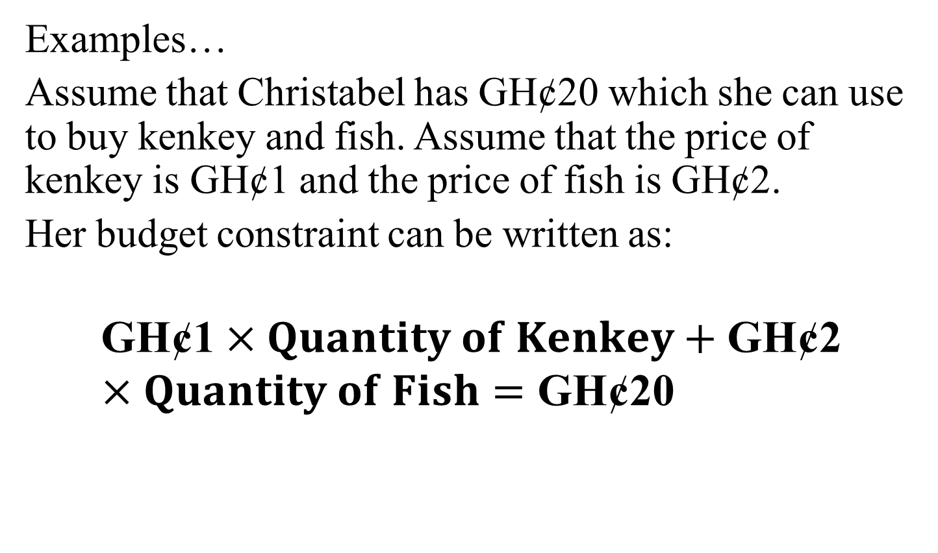
Optimization Trade-offs and Budget Constraints
Examples…
Assume that Christabel has GH¢20 which she can use to buy kenkey and fish. Assume that the price of kenkey is GH¢1 and the price of fish is GH¢2.
Her budget constraint can be written as:
$$\text{GH}\text{¢1}×Quantity of Kenkey+\text{GH}\text{¢2}×Quantity of Fish=\text{GH}\text{¢20}$$

Slide 31
Optimization Trade-offs and Budget Constraints
Suppose that you have 5 free hours in a day (once we take away necessities like sleeping, eating, bathing, attending classes, doing problem sets, and studying for exams).
Think of these 5 free hours as your budget of free time. Then your budget constraint would be:
5 hours = Hours on social media + Hours working at part-time job.

Slide 32
Opportunity Cost
The other important tool in the analysis of optimization is Opportunity Cost..
Opportunity cost is the best alternative use of a resource.
It is defined as the next best alternative forgone.
Opportunity cost is what an optimizer is effectively giving up when she undertakes an activity.
*****The concept of opportunity cost applies to all resources****

Slide 33
Budget | Hours Surfing Social Media | Hours at Part-Time Job
5 hours | 0 hours | 5 hours
5 hours | 1 hours | 4 hours
5 hours | 2 hours | 3 hours
5 hours | 3 hours | 2 hours
5 hours | 4 hours | 1 hours
5 hours | 5 hours | 0 hours

Slide 34
Cost Benefit Analysis
Cost-benefit analysis is a calculation that adds up costs and benefits using a common unit of measurement, like Ghana Cedis.
It is used to identify the alternative that has the greatest net benefit, which is equivalent to benefits minus costs.

Slide 35
Cost Benefit Analysis: Example
Should I cook or Buy Food: (Assuming same Quality).
Assume a plate of fried rice and chicken cost 15 Ghana Cedis…..
An agent who wants to optimize will calculate the alternative to buying, like ingredients, time, gas, etc, and put monetary value on it…….

Slide 36
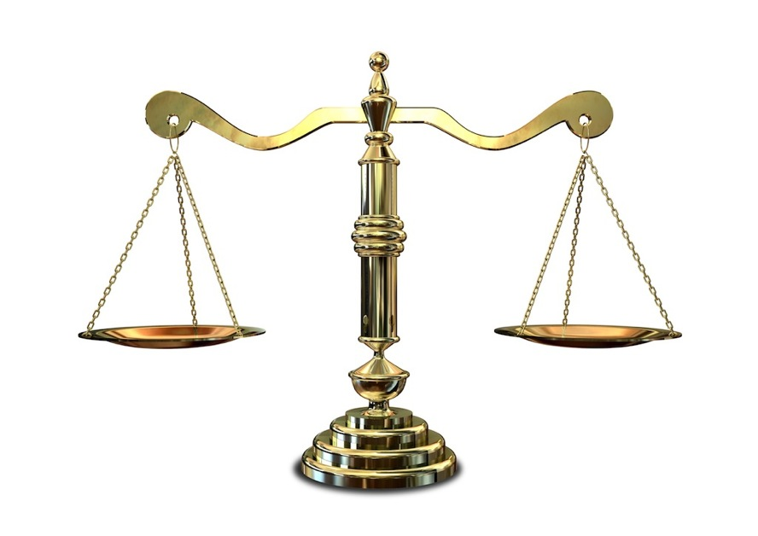
Cost Benefit Analysis
COSTS
BENEFITS

Slide 37
The Second Principle of Economics: Equilibrium
A situation in which no one benefits by changing his/her behavior.
Thus equilibrium is the special situation in which everyone is optimizing in the society, so nobody would benefit personally by changing his or her own behavior.

Slide 38

What Does Equilibrium Really Mean?

Slide 39
Equilibrium: An Illustration
To illustrate the concept of equilibrium, consider the length of the regular checkout lines at a supermarket.
If any line has a shorter wait than the others, optimizers will choose that line.
If any line has a longer wait than the others, optimizers will avoid that line. So the short lines will attract shoppers, and the long lines will drive them away. And it’s not just the length of the lines that matters.

Slide 40
Equilibrium: An Illustration
You pick your line by estimating which line will move the fastest, which incorporates everything that you can see, including the number of items in each person’s shopping cart.
Economists say that “in equilibrium” all of the checkout lines will have roughly the same wait time.

Slide 41
Equilibrium: The Free Rider Problem
The Free Rider Problem exists when an individual or group is able to enjoy the benefits of a situation without incurring the costs

Slide 42
Equilibrium: The Free Rider Problem
Group needs to decide what is fair.
Some sort of pressure needs to be put on the free rider to get him to conform
Markets have no mechanism for deciding what is fair

Slide 43
The Third Principle of Economics: Empiricism
Economists test their ideas with data.
We call such evidence-based analysis, empirical analysis or empiricism.
Economists use data to determine whether our theories about human behavior—like optimization and equilibrium—match up with actual human behavior.

Slide 44
Why Study Economics?
1. To Learn a Way of Thinking
In order to do this, we must understand Three fundamental concepts:
Opportunity cost
Marginalism
Efficient markets

Slide 45
Why Study Economics?
2. To Understand Society
The study of economics is an essential part of the study of society. One thing that is very important about our modern society is the industrial revolution

Slide 46
Why Study Economics?
3. To Understand Global Affairs
An understanding of economics is essential to an understanding of global affairs. The fracas between USA and china concerning exchange rates could only be understood if one is well vexed in the subject of economics.

Slide 47
Why Study Economics?
4. To Be an Informed Citizen
To be an informed citizen requires a basic understanding of economics.

Slide 48
Economic Policy
Criteria for judging economic outcomes:
1. Efficiency
2. Equity
3. Growth
4. Stability

Slide 49
Economic Policy
Efficiency: An efficient economy is one that produces what people want at the least possible cost.
equity means Fairness. This is highly normative

Slide 50
Economic Policy
economic growth: An increase in the total output of an economy
Stability: A condition in which national output is growing steadily, with low inflation and full employment of resources.

Slide 51
The Economic Problem: Scarcity and Choice

Slide 52
The Problem of Scarcity
There is a central economic problem that everyone faces. This central economic problem is the problem of scarcity.
Scarcity is the excess of human wants over what can actually be produced to fulfill these wants.
The resources or factors of production are limited but human needs or wants are unlimited

Slide 53
The Problem of Scarcity
The reason for scarcity is thus:
Human wants are virtually unlimited, whereas the resources available to satisfy these wants are limited.
Because of scarcity, various choices have to be made between alternatives.

Slide 54
The Problem of Scarcity
One thing you must understand is that we do not all face the problem of scarcity to the same degree. For instance, a poor person unable to afford enough to eat or a decent place to live will hardly see it as a ‘problem’ that a rich person cannot afford a second BMW.
But given that people, both rich and poor, want more than they can have, this makes them behave in certain ways.
Economics studies that behaviour.

Slide 55
The Problem of Scarcity
In short, Economics studies anything to do with the process of satisfying human wants using available resources.

Slide 56
The Ten facts of Economics
PEOPLE FACE TRADEOFFS (there is nothing like free lunch)
Individuals as well as societies face tradeoff….. For something to be done, we must always sacrifice something.
For individual…. Learn or club, education or work.
For societies…. “Guns and butter.”
One tradeoff society faces is between efficiency and equity.

Slide 57
The Ten facts of Economics
2. THE COST OF SOMETHING IS WHAT YOU GIVE UP TO GET IT
Because people face tradeoffs, making decisions requires comparing the costs and benefits of alternative courses of action.
In many cases, however, the cost of some action is not as obvious as it might first appear. For university education, the benefit is intellectual enrichment but the cost goes beyond fee and time spent in school

Slide 58
The Ten facts of Economics
RATIONAL PEOPLE THINK AT THE MARGIN
4. PEOPLE RESPOND TO INCENTIVES….
Because people make decisions by comparing costs and benefits, their behavior may change when the costs or benefits change.

Slide 59
The Ten facts of Economics
5. TRADE CAN MAKE EVERYONE BETTER OFF
6. MARKETS ARE USUALLY A GOOD WAY TO ORGANIZE ECONOMIC ACTIVITY
7. GOVERNMENTS CAN SOMETIMES IMPROVE MARKET OUTCOMES

Slide 60
The Ten facts of Economics
8. A COUNTRY’S STANDARD OF LIVING DEPENDS ON ITS ABILITY TO PRODUCE GOODS AND SERVICES
9. PRICES RISE WHEN THE GOVERNMENT PRINTS TOO MUCH MONEY
10. SOCIETY FACES A SHORT-RUN TRADEOFF BETWEEN INFLATION AND UNEMPLOYMENT

Slide 61
What do Economists Study?
Production and consumption
Production has to do with the transformation of inputs into outputs by firms in order to earn profit (or meet some other objective).
Consumption is the act of using goods and services to satisfy wants. This will normally involve purchasing the goods and services.

Slide 62
Factors of production
As indicated, Production is the process by which resources are transformed into useful forms.
For firms to produce, they need resources or factors of production.
Resources, or inputs, refer to anything provided by nature or previous generations that can be used directly or indirectly to satisfy human wants.
There are three factors of production:
Capital resources……… Capital
Human resources..... Labour
Natural resources….Land

Slide 63
Factors of production
Labour
Labour refers to all forms of human input, both physical and mental that goes into current production. The reward for labour is Wages
Land and raw materials
Inputs into production that are provided by nature: e.g. unimproved land and mineral deposits in the ground. The reward for land is Rent

Slide 64
Factors of production
Capital
All inputs into production that have themselves been produced: e.g. factories, machines and tools.
The reward for capital is Interest

Slide 65
Three basic questions must be answered in order to understand an economic system
The mechanics of decision making in a larger economy are more complex, but the type of decisions that must be made are nearly identical.
All societies must decide:
What will be produced?
How will it be produced?
Who will get what is produced?

Slide 66
The production possibility curve
The curve shows all the combinations of the two goods that can be produced with all the nation’s resources fully and efficiently employed.

Slide 67
The production possibility curve
A
B
C
D
Capital Goods
E
F
Consumer Goods

Slide 68
The production possibility curve
The production possibility frontier curve has a negative slope that indicates the trade-off that a society faces between two goods.
The slope of the ppf is also called the marginal rate of transformation (MRT).
The marginal rate of transformation describes numerically the rate at which output of one good can be transformed (by re-allocation of production resources) into output of the other

Slide 69
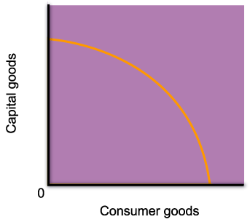
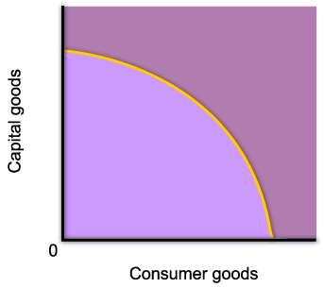
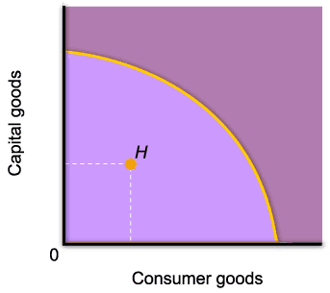
The production possibility curve
Points inside of the curve are inefficient.
At point H, resources are either unemployed, or are used inefficiently.

Slide 70

The production possibility curve
Points outside the PPF are unattainable.
Point F is desirable because it yields more of both goods, but it is not attainable given the amount of resources available in the economy.

Slide 71

The production possibility curve
Points on the PPF represent full and efficient allocation of resources.
Point C is one of the possible combinations of goods produced when resources are fully and efficiently employed.

Slide 72



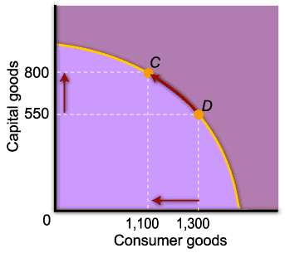
The production possibility curve
A move along the curve illustrates the concept of opportunity cost.
In order to increase the production of capital goods, the amount of consumer goods will have to decrease.

Slide 73
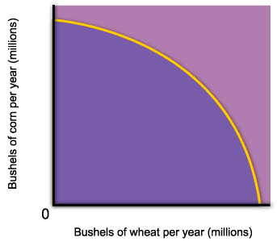
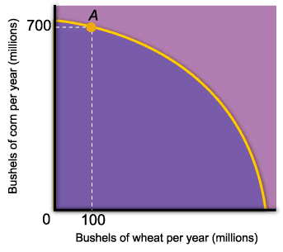
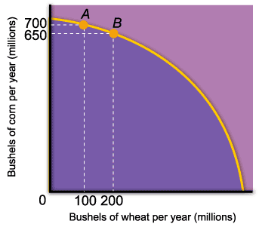
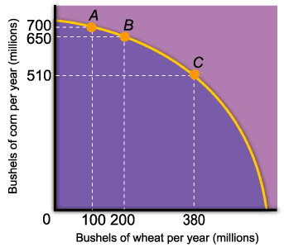
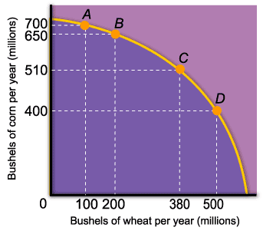
The production possibility curve
The concave shape of the production possibility frontier curve reflects the law of increasing opportunity cost.
As we increase the production of one good, we sacrifice progressively more of the other.

Slide 74
Economic Growth
The outward shift of the PPF represent economic growth
Economic growth is an increase in the total output of the economy. It occurs when a society acquires new resources, or when it learns to produce more using existing resources.
The main sources of economic growth are capital accumulation and technological advances.

Slide 75
Economic Growth
Food
Now
O
Clothing

Slide 76
Economic Growth
Future
Food
Now
O
Clothing

Slide 77
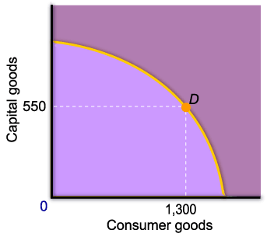
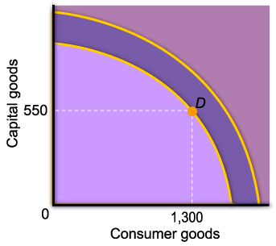
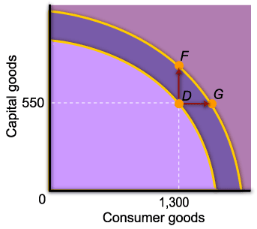
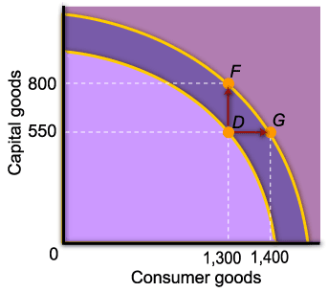
Economic Growth
To increase the production of one good without decreasing the production of the other, the PPF curve must shift outward.
From point D, the economy can choose any combination of output between F and G.

Slide 78
Which of the following would shift the p.p. curve outwards?
Q
An increase in the population of working age
A reduction in unemployment
A reduction in VAT
An increase in the general level of prices
A reduction in expenditure on education

Slide 79
Economic Systems
An economic system refers to the particular way in which economic activities takes place in an economy.
In other words, an economic system refers to the particular set of institutional arrangement or mechanism by which ownership and use of resources in an economy are determined.

Slide 80
Economic Systems
There are basically three classifications of economic systems. These are;
Centrally planned or command economy
Free-market economy
Mixed economy

Slide 81
Classifying economic systems
Mid 1980s
N. Korea
China
UK
Hong
Kong
Cuba
Poland
France
USA
Totally
planned
economy
Totally
free-market
economy
N. Korea
Cuba
China
Poland
France
USA
UK
China
(Hong
Kong)
Late 2000s

Slide 82
Economic Systems: The command economy
A command economy is an economy where all economic decisions are taken by the central authorities.

Slide 83
Features of a command economy
The state plans the output of each industry and firm.
It plans the distribution of output between consumers.
It plans the allocation of resources between current consumption and investment for the future.

Slide 84
Advantages of a command economy
high investment, high growth
stable growth
social goals pursued
low unemployment

Slide 85
Problems of a command economy
problems of gathering information
expensive to administer
inappropriate incentives
shortages and surpluses

Slide 86
The free-market economy
A free market economy is an economy where all economic decisions are taken by individual households and firms and with no government intervention.
demand and supply decisions
the price mechanism
the interdependence of markets

Slide 87
Advantages of a free-market economy
transmits information between buyers and sellers
no need for costly bureaucracy
incentives to be efficient
competitive markets responsive to consumers

Slide 88
Problems of a free-market economy
Competition may be limited: problem of market power
Inequality
The environment and other social goals may be ignored

Slide 89
The mixed economy
An economy where economic decisions are made partly by the government and partly through the market.
Because of the problems of both free-market and command economies, all real-world economies are a mixture of the two systems.

Slide 90
Methods of Economic Studies: Theories and Models
Model: A formal statement of a theory, usually a mathematical statement of a presumed relationship between two or more variables.
Examples are Demand Models, Consumption Model. etc. it is an abstraction of reality

Slide 91
Methods of Economic Studies: Theories and Models
Variable: A measure that can change from time to time or from observation to observation. For Example, Price, income, Quantity of Yam, Etc.
Ockham’s razor The principle that irrelevant detail should be cut away

Slide 92
The Principles of All Else Equal: Ceteris Paribus
Ceteris paribus, or all else equal: A device used to analyze the relationship between two variables while the values of other variables are held unchanged.
Using the device of ceteris paribus is one part of the process of abstraction. In formulating economic theory, the concept helps us simplify reality to focus on the relationships that interest us.

